Slide 1
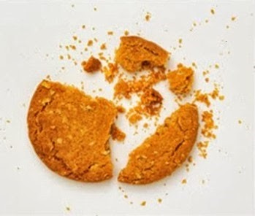

Test Automation Using Selenium
Fair Hike Academy
That’s the way the cookie crumbles!
Session 5: Object Identification using Firebug and Developer Tool, xPath
Mentor : Naresh Vulli, CSTE, PAHM.
fairhike@gmail.com www.fairhike.blogspot.com | www.facebook.com/fairhike

Slide 2
Today’s Topics
Recap
Object/Element Identification
Locators
Tools for Object Identification
Firebug & supporting Tools Installation
xPath Construction
xPath Axes
Takeaways or Exercise

Slide 3
Object/Element Identification
Object or Element is the target location where we perform an action or validation
An element can be a button, textbox, Hyperlink or dropdown combo box etc.
A good object identification mechanism eliminates confusion with duplicate element properties and should find element within reasonable time

Slide 4
Locators
ID
Name
Xpath
CSS Selector
Class
tagName
Link Text
partialLinkText

Slide 5
Tools for Object Identification
Firebug
Developer Tools
FirePath
FireFinder

Slide 6
Firebug Installation
https://addons.mozilla.org/en-US/firefox/addon/firebug/
Click “Add to Firefox”
Choose “Install” option
Restart the browser
Tools → WebDeveloper → Firebug →Open Firebug

Slide 7
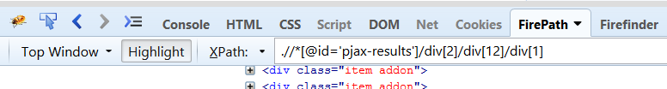
FirePath and FireFinder Installation
https://addons.mozilla.org/en-US/firefox/addon/firepath/
https://addons.mozilla.org/en-US/firefox/addon/firefinder-for-firebug/

Slide 8
xPath Construction
XPath (XML Path Language) is a query language that can be used to query data from XML documents
Absolute Xpath : html/head/body/table/tbody/tr/th
Relative Xpath : //input[@id='twotabsearchtextbox']
XPath Axes :
//input[@id='email']/following::*
//select[@id='day']/preceding-sibling::select/

Slide 9
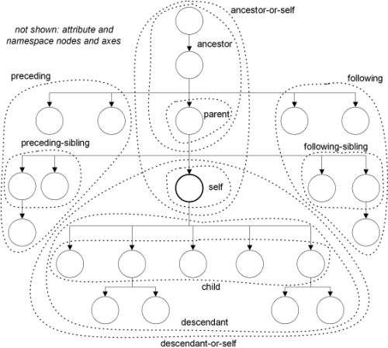
XPath Axes

Slide 10
Takeaway or Exercise
Install and explore different tools available of Object identification
Try to construct xPath using all 13 xpath Axes

Slide 11
Q & A

Slide 12
Thank You ☺

